Slide 1
PROJECT TITLE – TO INCREASE PHACETIME BETWEEN PATIENTS AND CLINICIANS
Final Review
Batch Number: CST-G04
Roll Number | Student Name
20211CST0068 | DEEKSHITH K A
20211CST0012 | Y AMARNATH CHOWDHARY
20211CST0060 | CHARAN G
20211CST0106 | VISHNU KUMAR K R
20211CST0135 | VIGNESH R
Under the Supervision of,
Dr. HARISH KUMAR
Assistant Professor
School of Computer Science & Engineering
Presidency University

Slide 2
Introduction
Increasing clinician-patient face time is crucial for enhancing healthcare outcomes, patient satisfaction, and overall care quality. Administrative tasks, documentation, and operational inefficiencies often limit the time clinicians spend directly interacting with patients. By streamlining processes, optimizing electronic health record (EHR) systems, and effectively utilizing support staff, healthcare providers can free up valuable time for meaningful patient engagement. Leveraging technology such as telemedicine and improving scheduling systems also contribute to reducing logistical barriers. More time with patients leads to better communication, stronger relationships, and more personalized care, benefiting both patients and clinicians while reducing burnout and improving job satisfaction.

Slide 3
Literature Review
Advantages:
Improved Patient Outcomes: More time with patients allows clinicians to conduct thorough assessments and provide personalized care, leading to better treatment outcomes.
Enhanced Patient Satisfaction: Direct engagement strengthens trust and communication, making patients feel heard and valued.
Reduced Clinician Burnout: Less administrative burden allows clinicians to focus on care delivery, improving job satisfaction and reducing stress.
Better Care Efficiency: Streamlined workflows and task delegation free up time for more meaningful patient interactions.
Stronger Clinician-Patient Relationships: Increased face time fosters deeper connections, improving long-term care and patient loyalty.

Slide 4
Literature Review
Disadvantages:
Initial Implementation Costs: Streamlining processes, optimizing EHR systems, and hiring additional support staff may require significant upfront investment.
Technology Dependency: Increased reliance on digital tools and telemedicine can create technical challenges, such as system failures or user errors.
Potential Workflow Disruption: Adjusting existing workflows to increase face time may cause temporary inefficiencies or resistance from staff accustomed to traditional methods.
Unequal Access to Resources: Not all healthcare settings, especially in underserved areas, may have access to the necessary technology or support staff.
Overemphasis on Time: Focusing solely on increasing face time might overlook the quality of interaction, where meaningful engagement is more important than the duration of visits.

Slide 5
Proposed Method
To address the identified research gaps, the proposed methodology combines advanced techniques in Retrieval-Augmented Generation (RAG) and large language models (LLMs) to develop two distinct but complementary solutions for medical question answering.

Slide 6
Objectives
The primary goal of this project is to develop an AI-powered medical chatbot that assists patients in addressing non-critical health concerns while ensuring that the advice provided is accurate, safe, and aligned with clinical best practices. By integrating advanced technologies like Retrieval-Augmented Generation (RAG) and large language models (LLMs), the chatbot aims to provide reliable, accessible healthcare information, empowering patients to make informed decisions. This system operates under the supervision of medical professionals to ensure that responses meet the highest standards of accuracy, safety, and patient care.

Slide 7
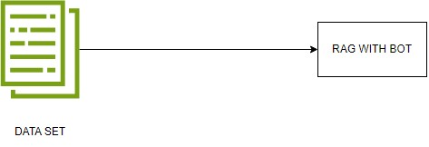
Methodology
1 chat with doctor data set
2 chat with medical data set

Slide 8
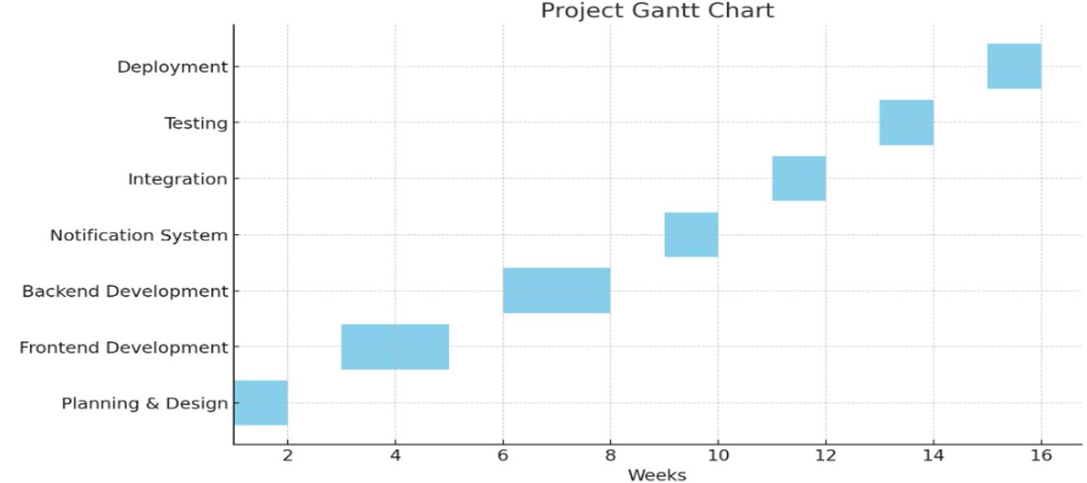
Timeline of Project

Slide 9
Expected Outcomes
Dual Application System: Two applications will be developed—one for users and another for doctors, each tailored to their specific needs.
Disease Detection for Doctors: The doctor app will specialize in diagnosing diseases like blood cancer and breast cancer, providing fast and reliable results.
Cost-Effective Performance: Both apps will ensure quick outputs while managing costs efficiently, optimizing both performance and scalability.

Slide 10
Conclusion
Increasing clinician-patient face time enhances care quality, improves patient outcomes, and fosters stronger relationships. By reducing administrative burdens, optimizing workflows, and utilizing technology, clinicians can focus more on patient care. This shift leads to better communication, increased satisfaction, and a more efficient, sustainable healthcare system for both patients and providers.

Slide 11
References
https://bmcmedinformdecismak.biomedcentral.com/articles/10.1186/1472-6947-14-94
https://www.sciencedirect.com/science/article/abs/pii/S1386505619304733
GitHub Link:
https://github.com/lakshmiprasadlp

Slide 12
Thank You

